Slide 1
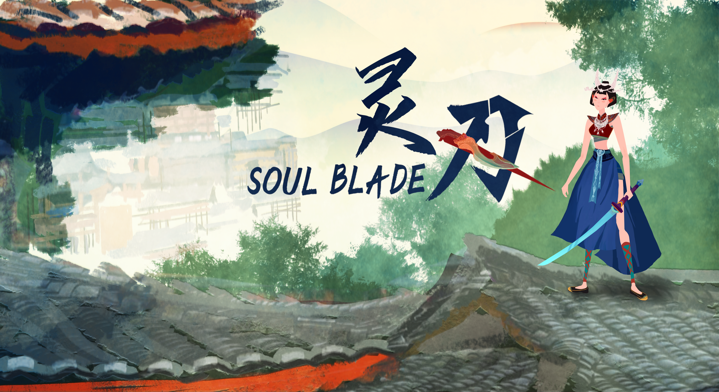
Elder Iron
Version 1.0.6

Slide 2
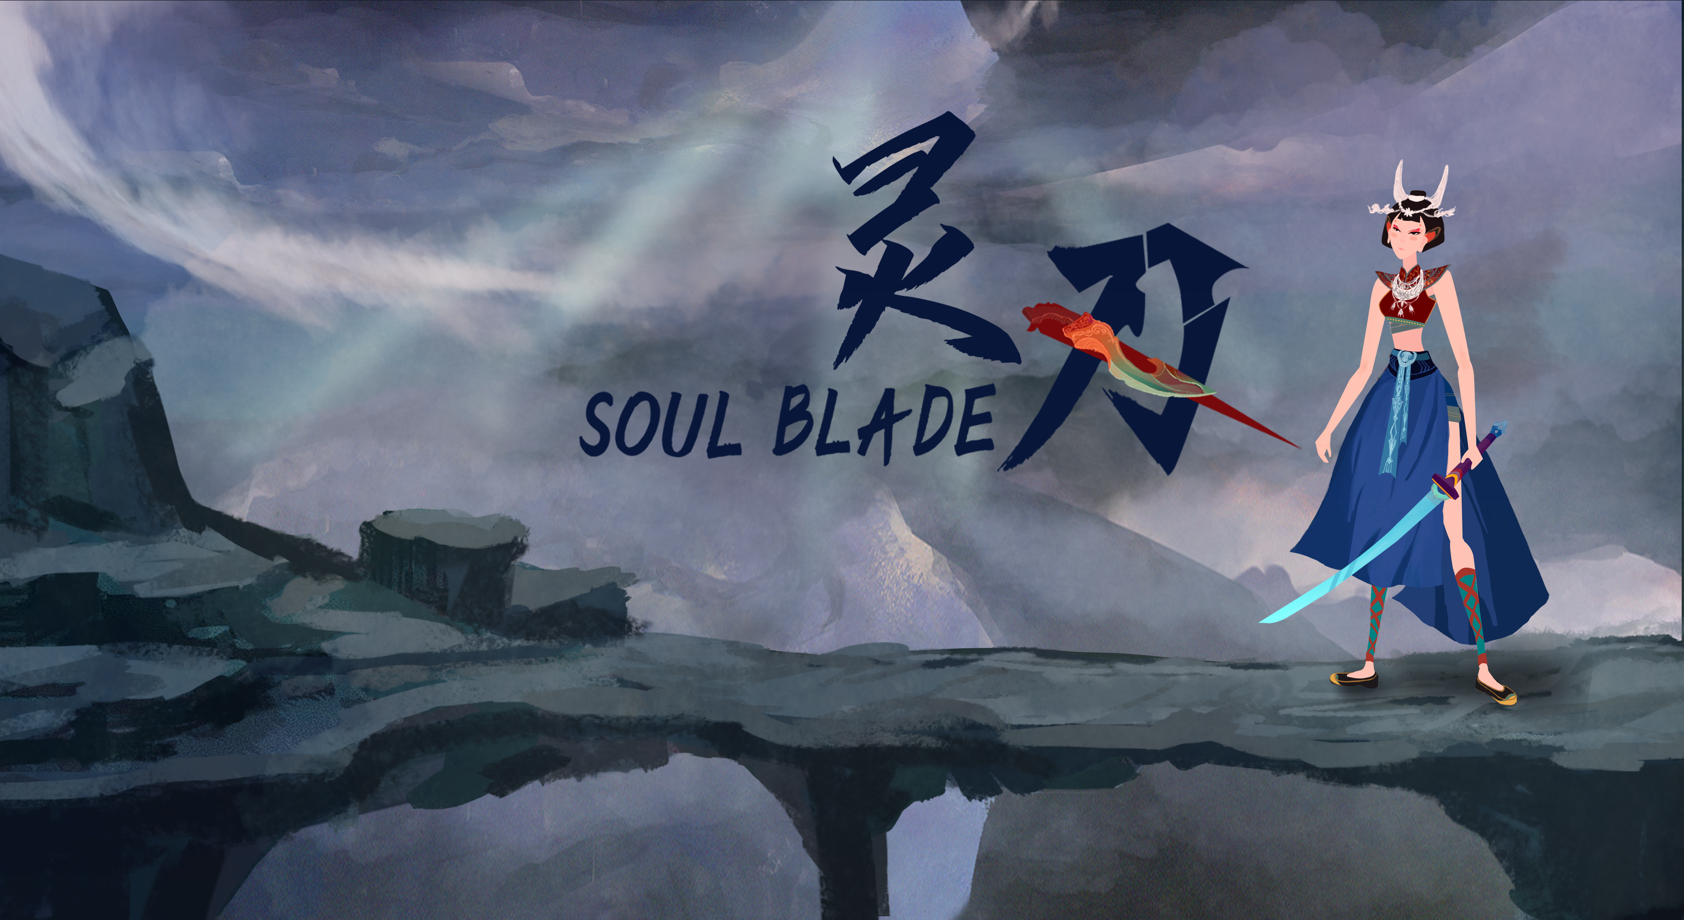
Introduction
Soul blade is a 2D action game based on ancient Chinese myth.
Platform：Unity
Player number：1
Art style：basic 2D art combined with special religious culture.
Core mechanism：
Combination of melee attack and ranged projectile.
Dynamic combat system and AI design
New understanding of old mythology.

Slide 3
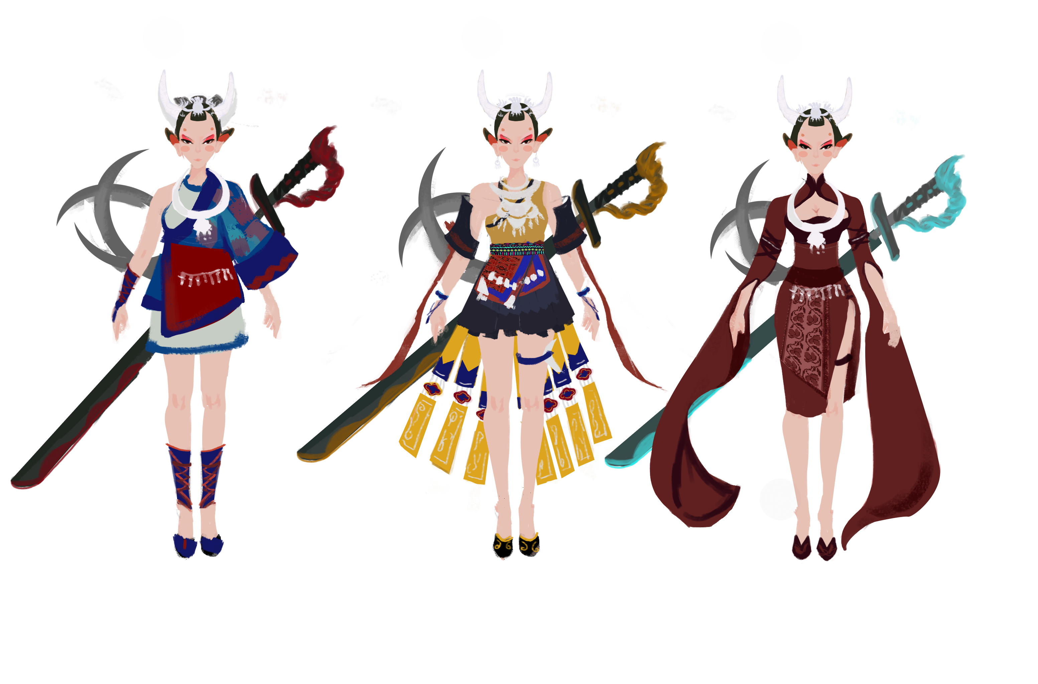
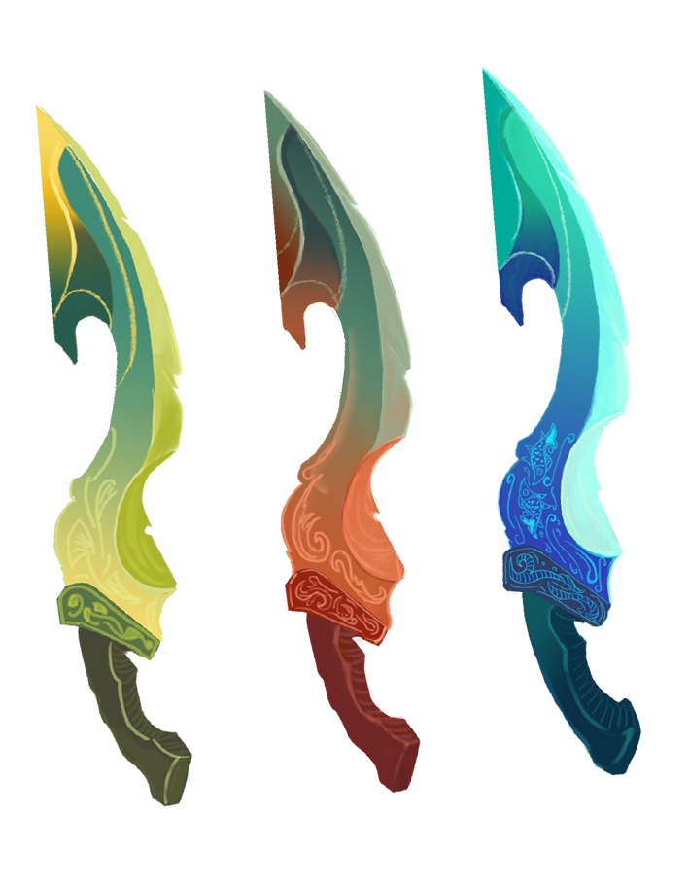
Background settings:
Theme: A girl on travel to send blades back home.
Time period: BC 2000, the famous war in Chinese history – War of Zhulu
Character settings：
Main character：A girl from Miao that doesn’t like to talk, have ability to talk to the spirit of the blades, the background and memory of her remain a mystery.
Three blades that come from the same place but have different personalities.

Slide 4
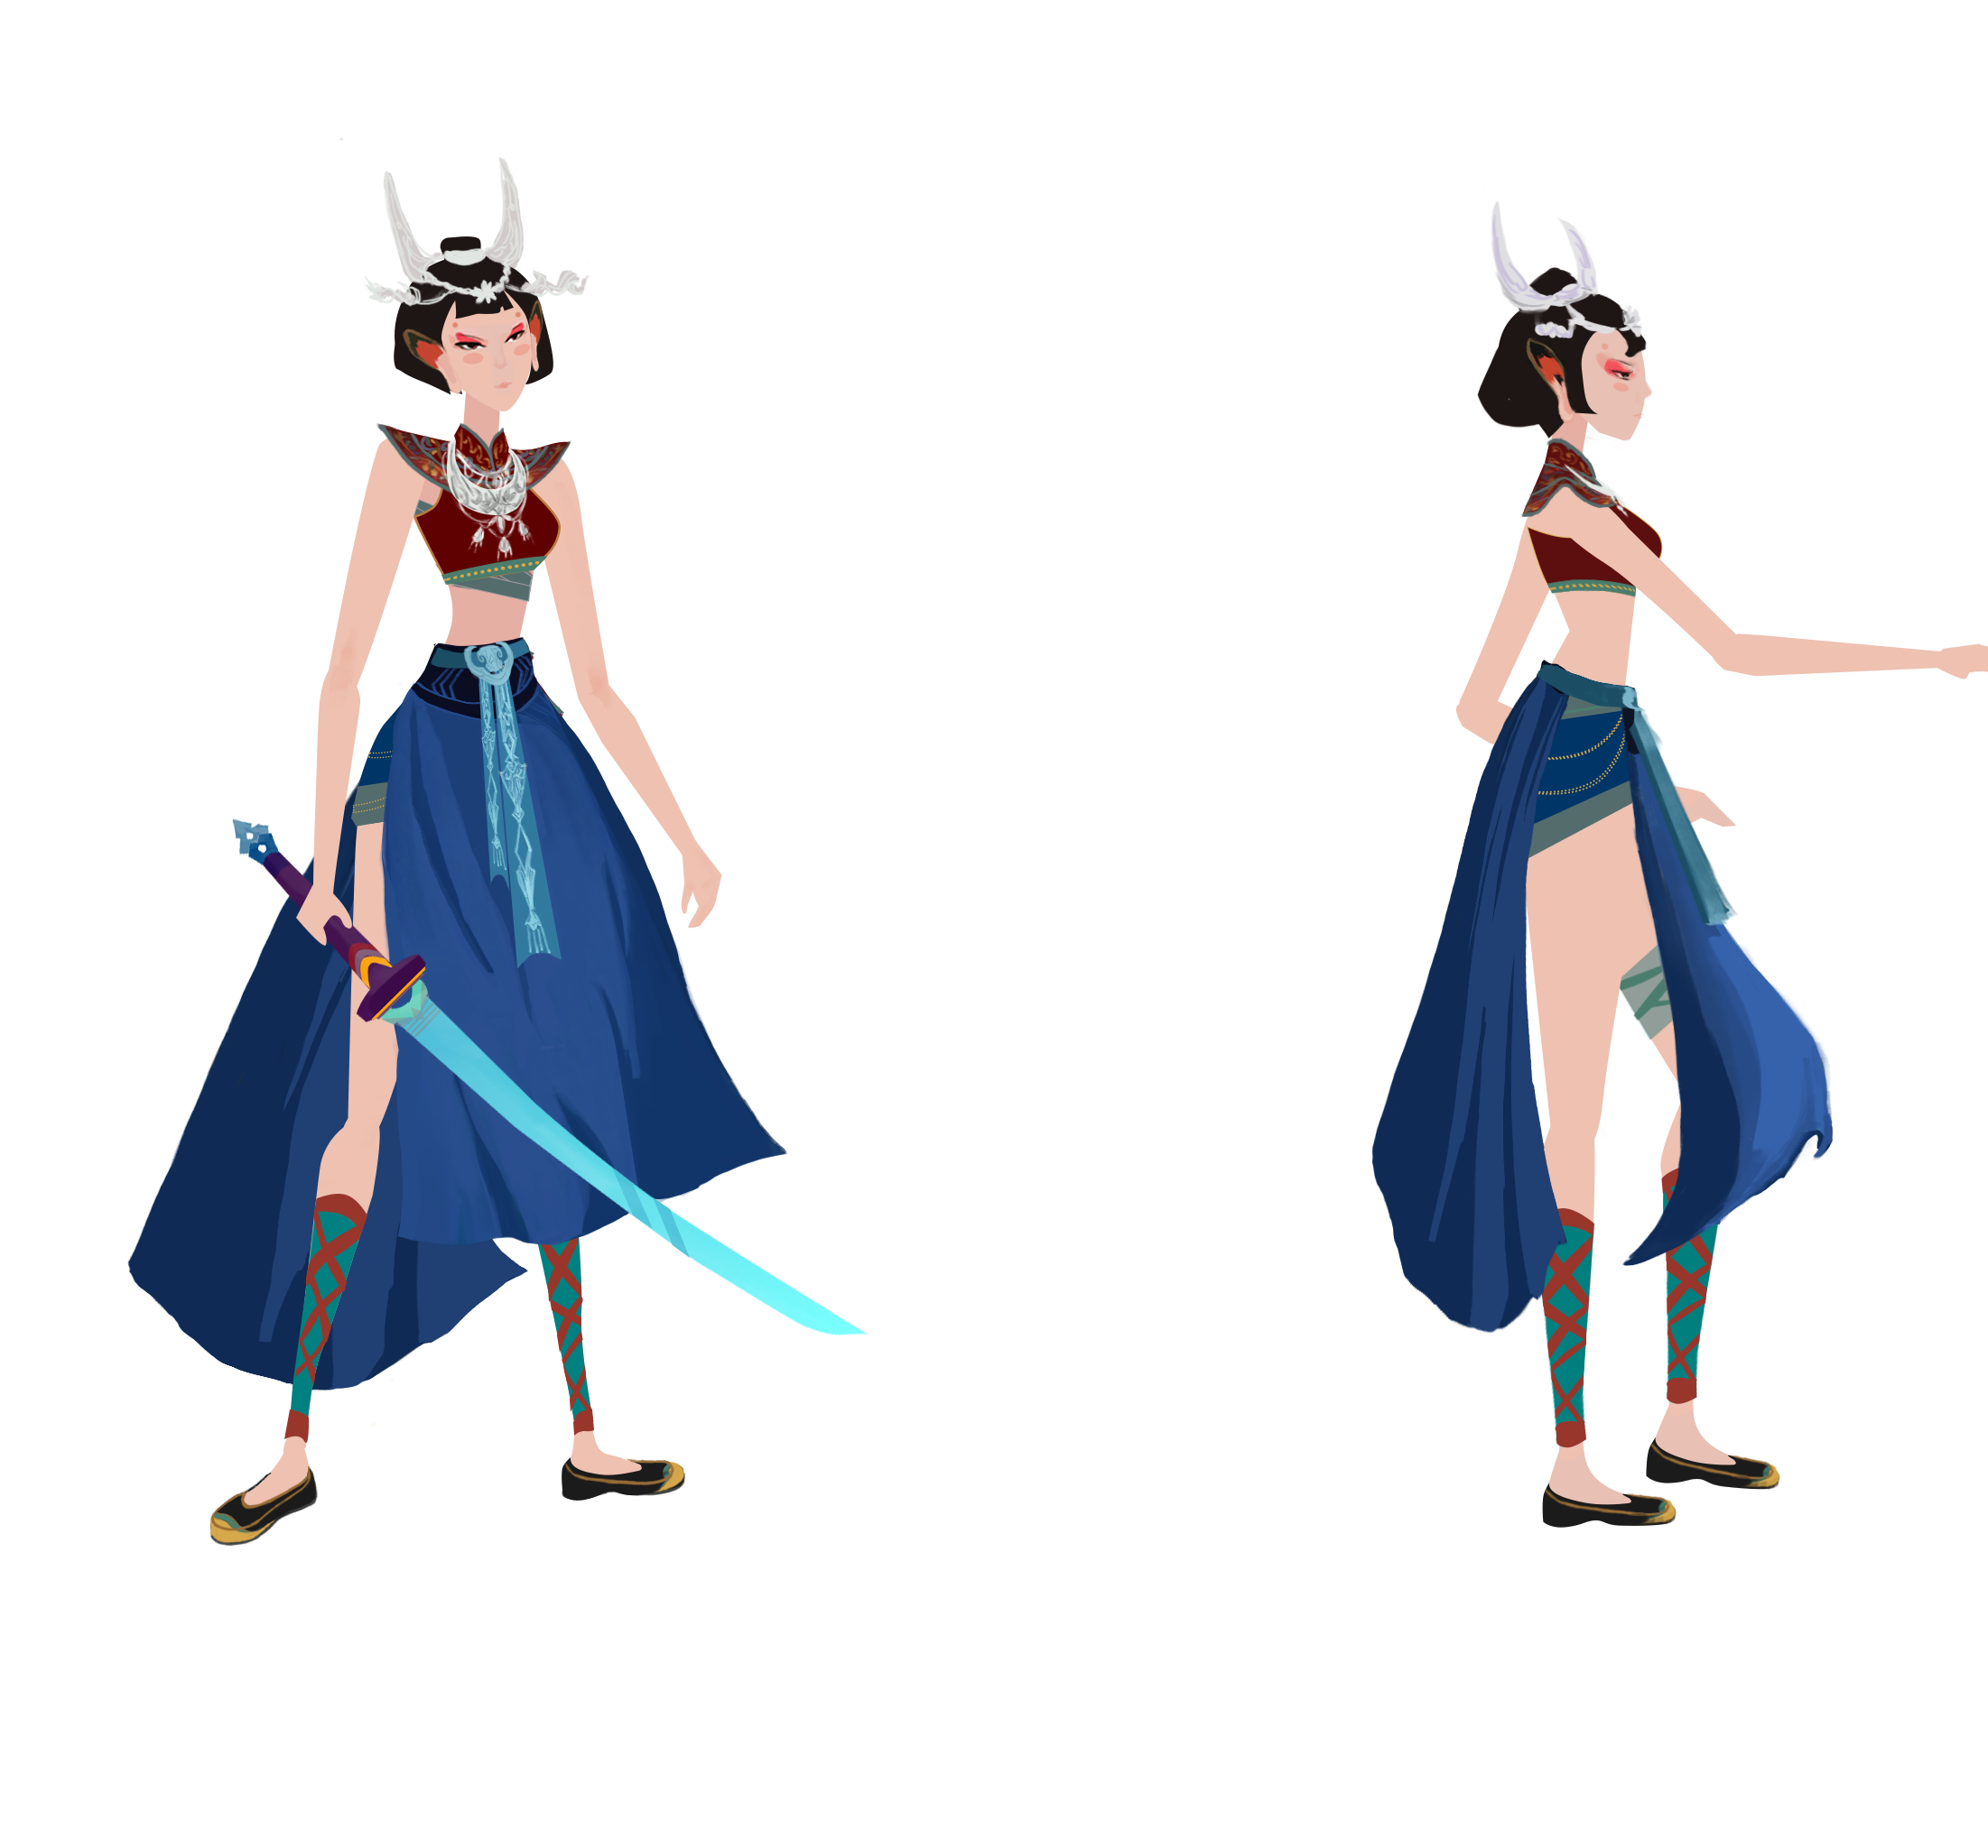
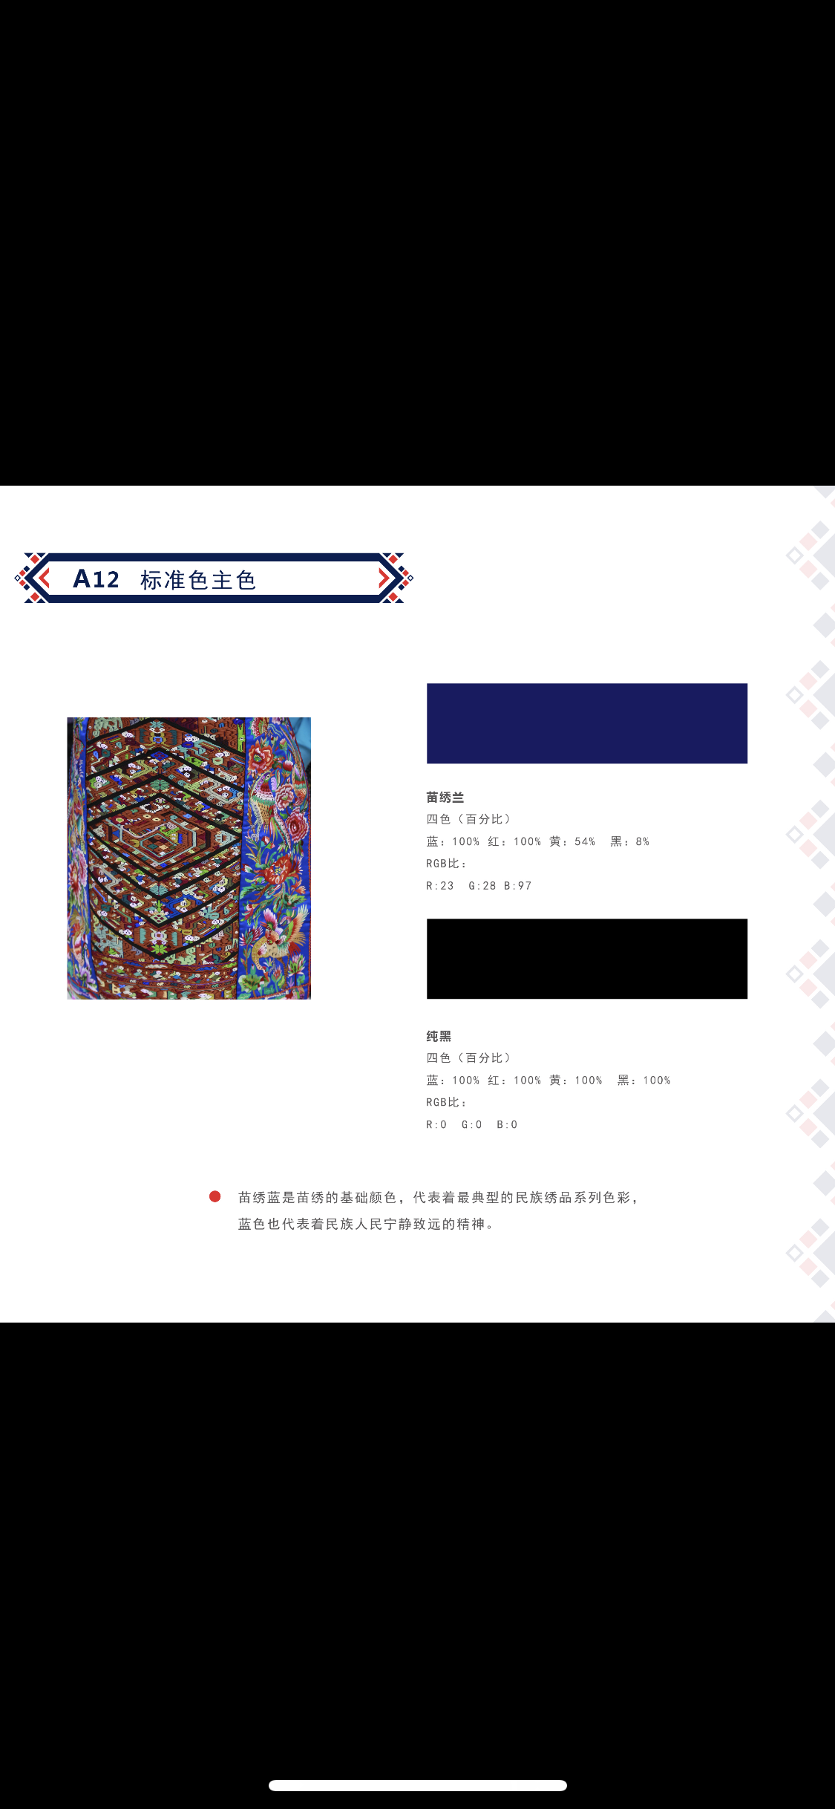
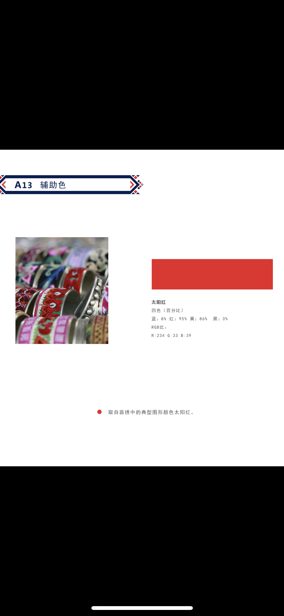
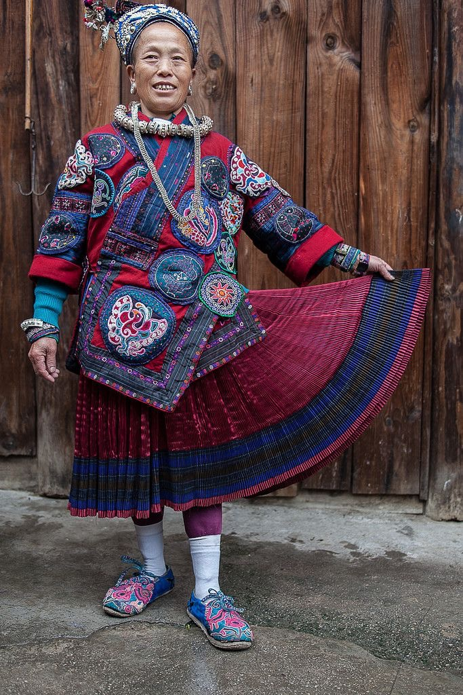
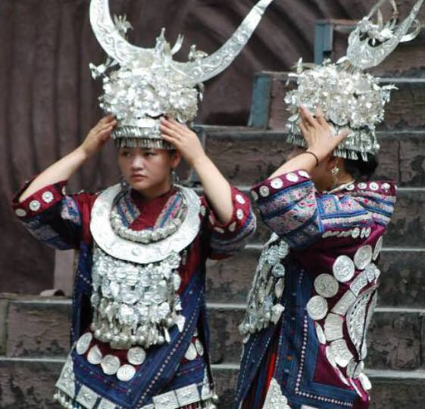
Art – Main Character
Tiara special designed based on Miao culture, represent the beauty of females.
Red color cloth based on classic Miao style.
The blue dress come from the traditional cloth of Miao region, represent their belief of bravery.

Slide 5
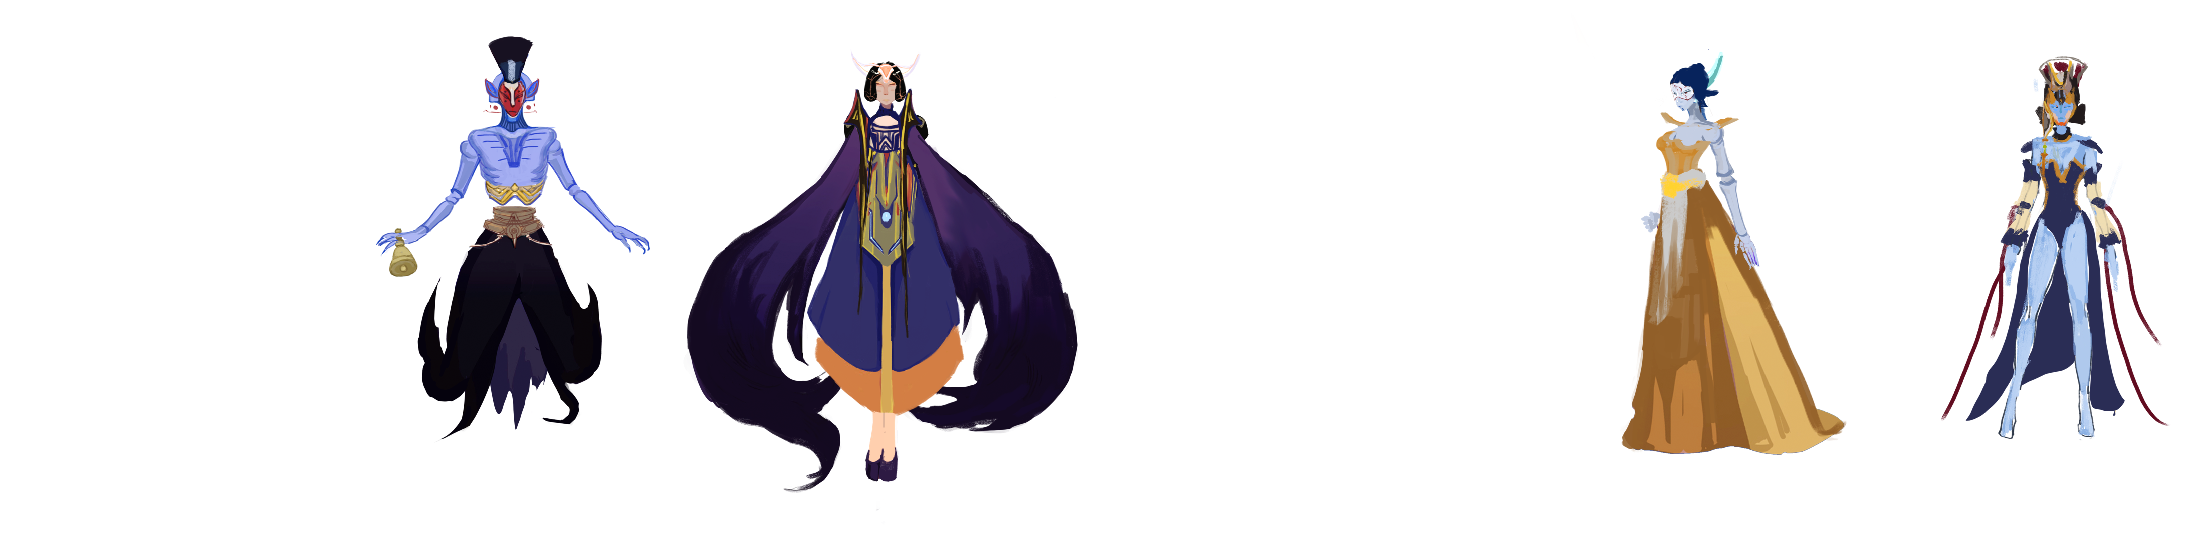
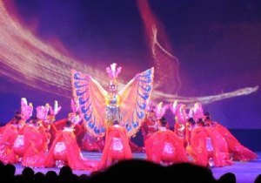
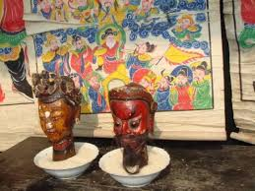
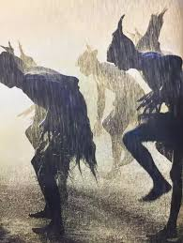
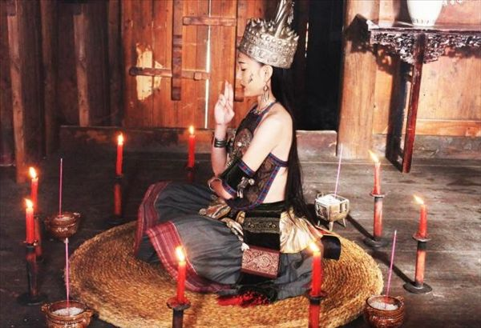
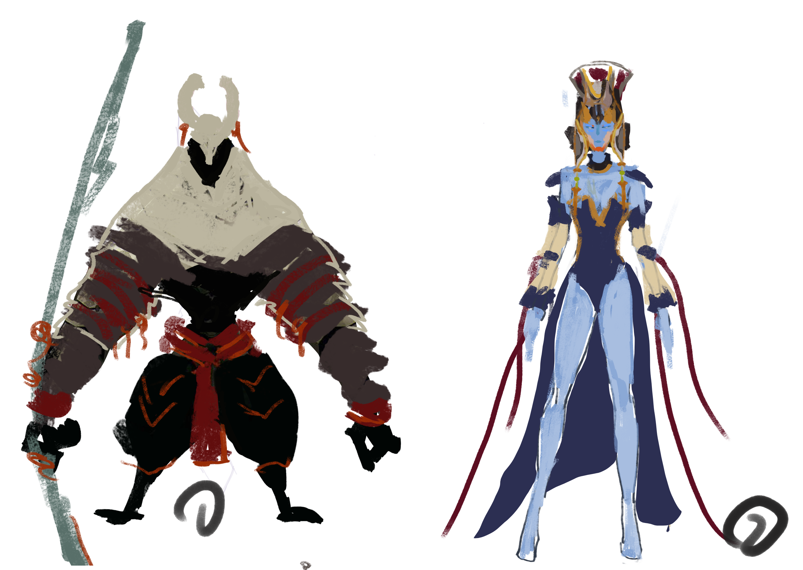
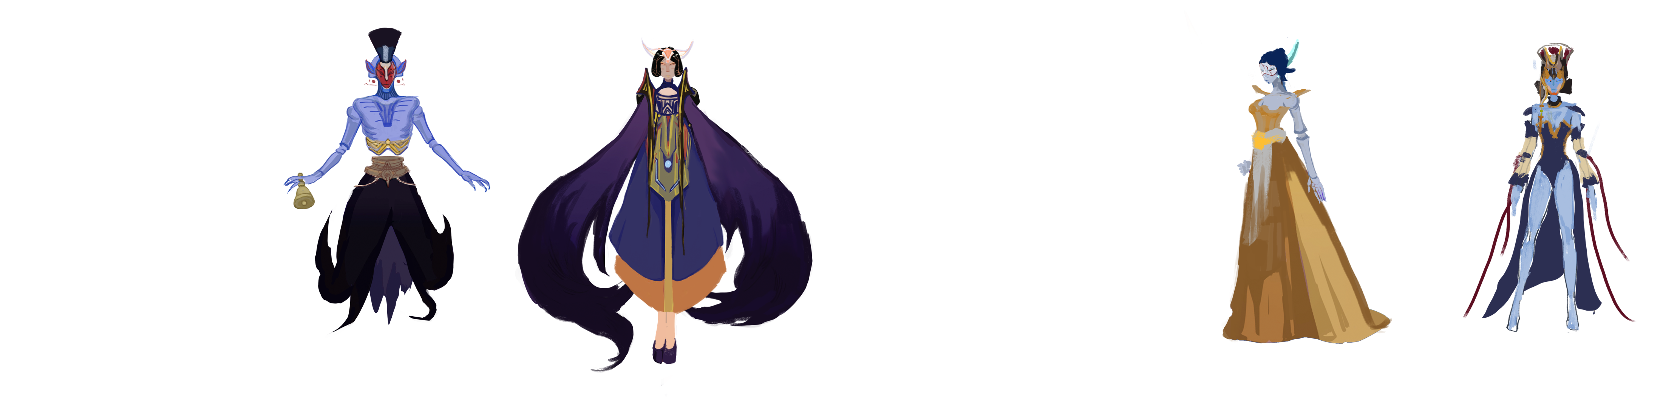
Art – BOSS
The inspiration of boss come form the witch culture of Miao region, and other mystery element from Chinese history.

Slide 6
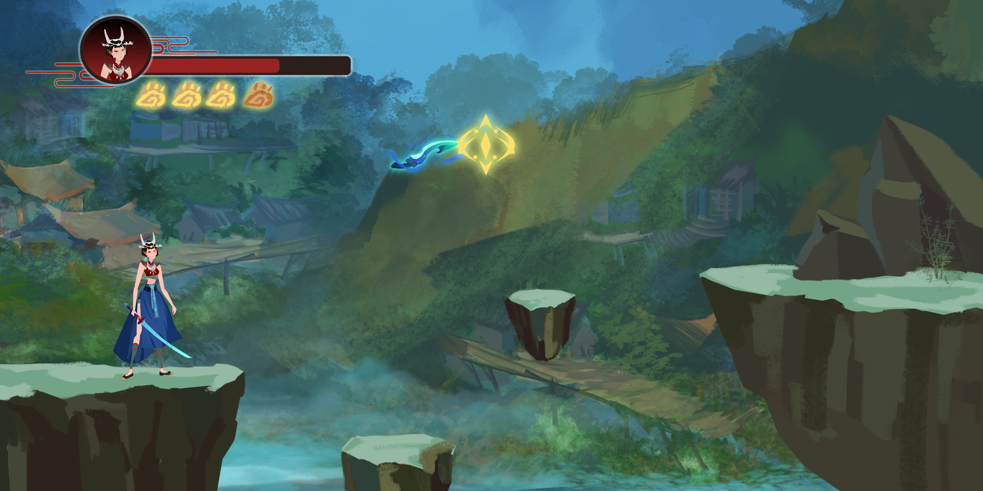
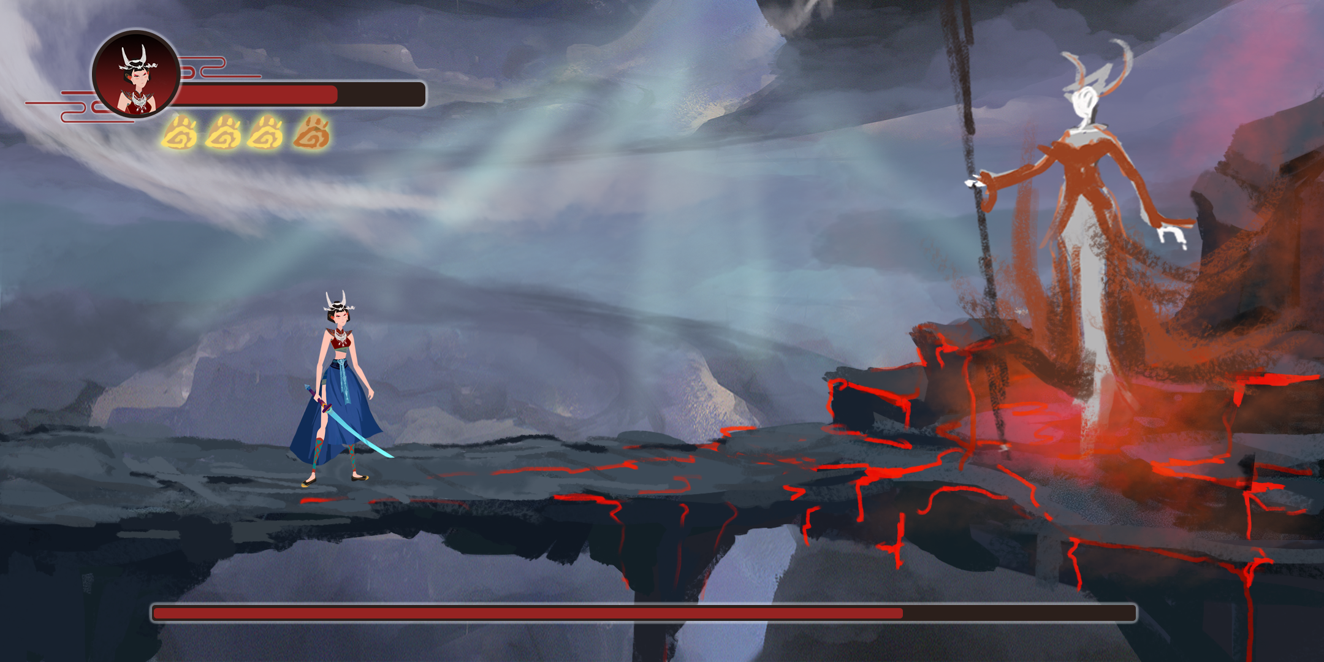
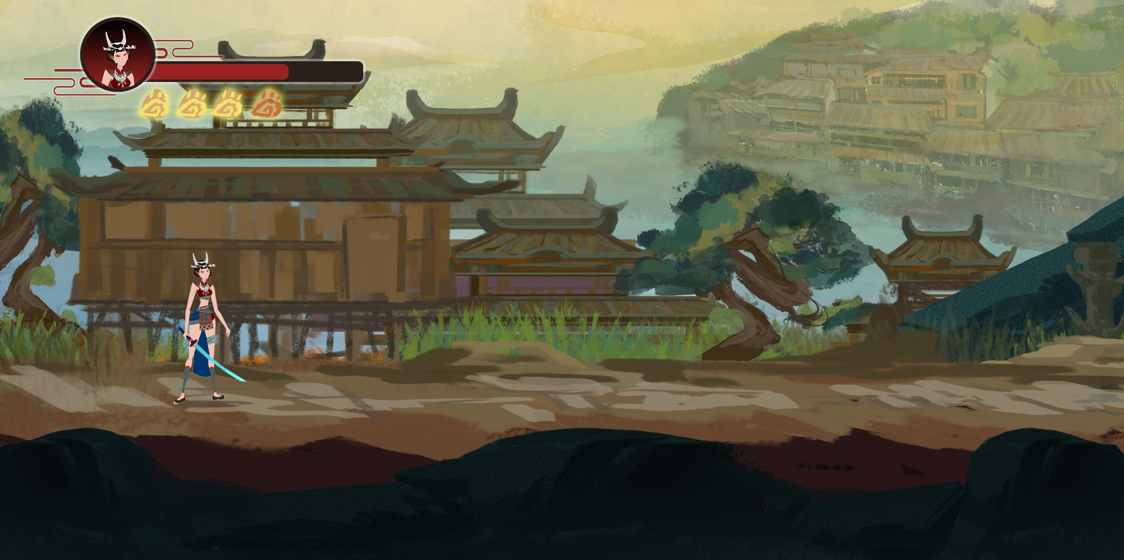
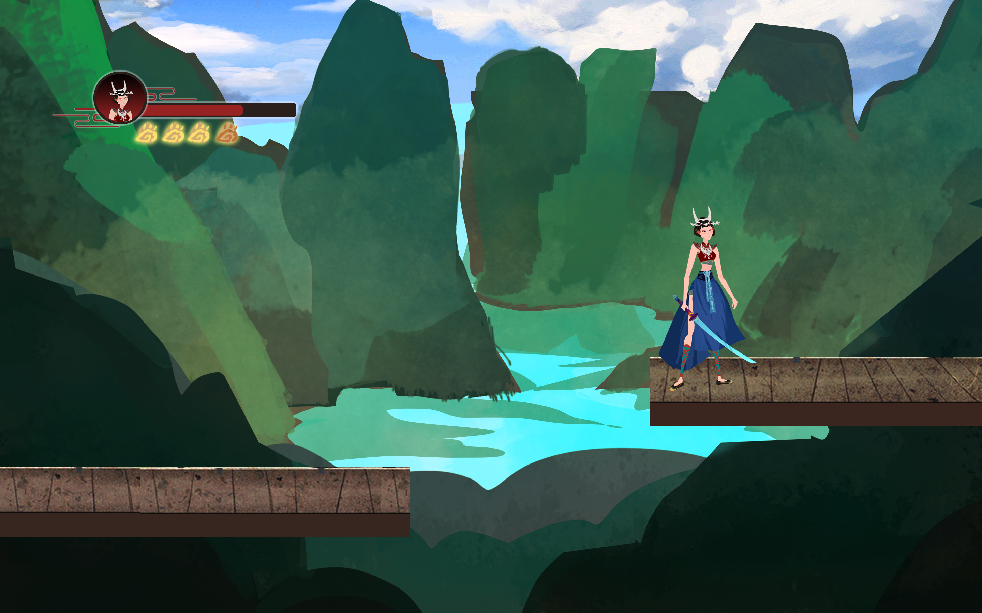
Environment design

Slide 7
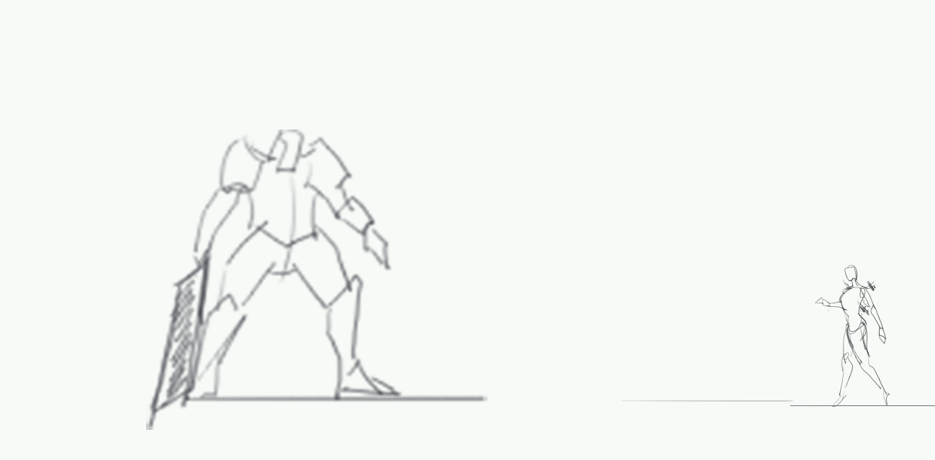
Mechanism --- Battle
动作拆解演示
Seize the timing to control the character to avoid the favorable position, you can turn risk into advantages, and play more combos :
Dash after jump to avoid the attack, to reach the position.
Shoot three blades from the position to the left bottom corner, which can be the combo.
When the weakness of the enemy moved down, using melee attack can hit the weakness again for more combo points.

Slide 8
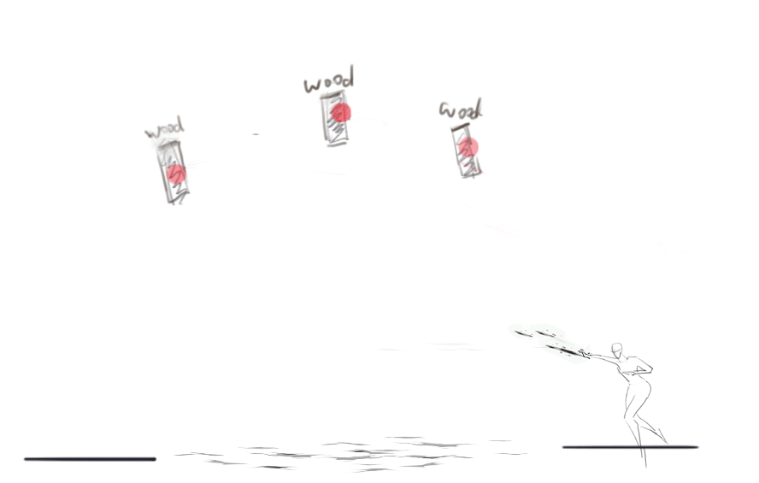
Mechanism --- Interactable element
动作拆解演示
Shoot the blades to the interactable points, the return of the blades give player an extra force to jump：

Slide 9
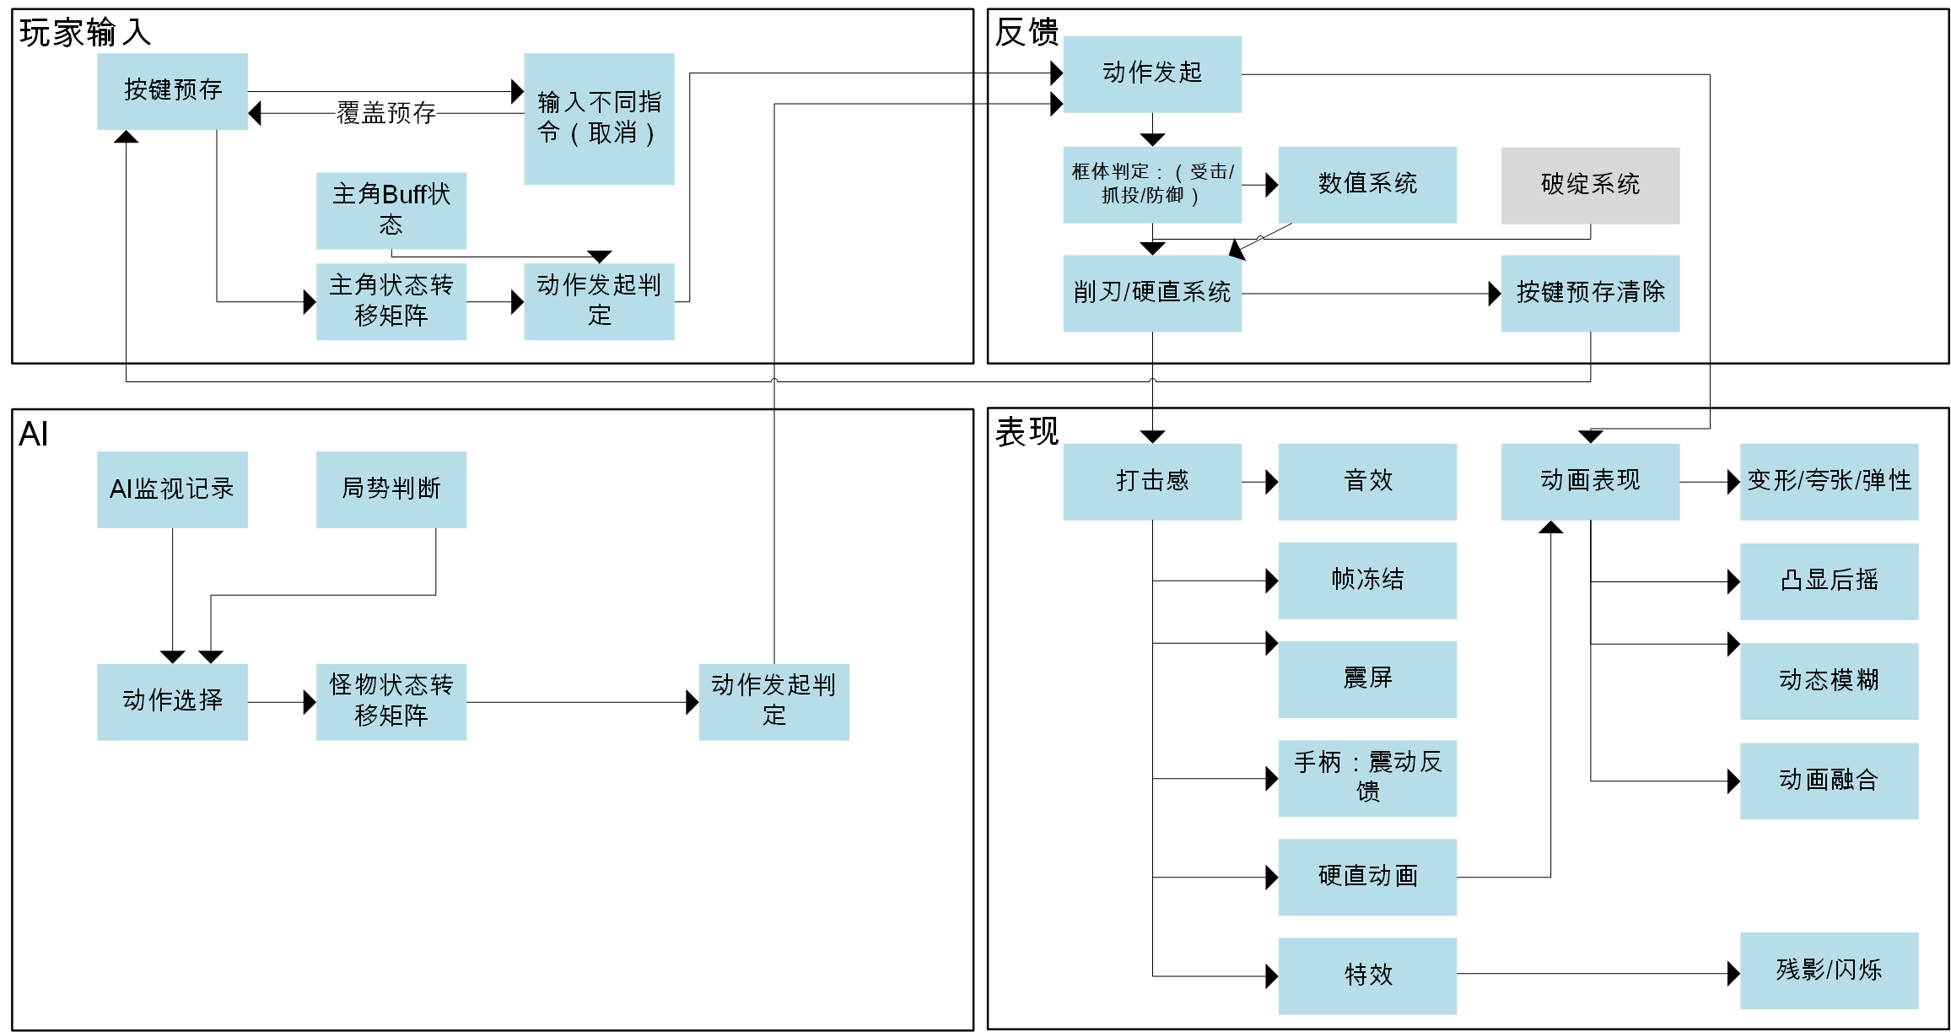
Game system
Action time limitation
Post action cancelling
Weakness and combo
Pre-loaded button reaction
Reaction to hit
Energy limitation system
Finite state machine of character

Slide 10
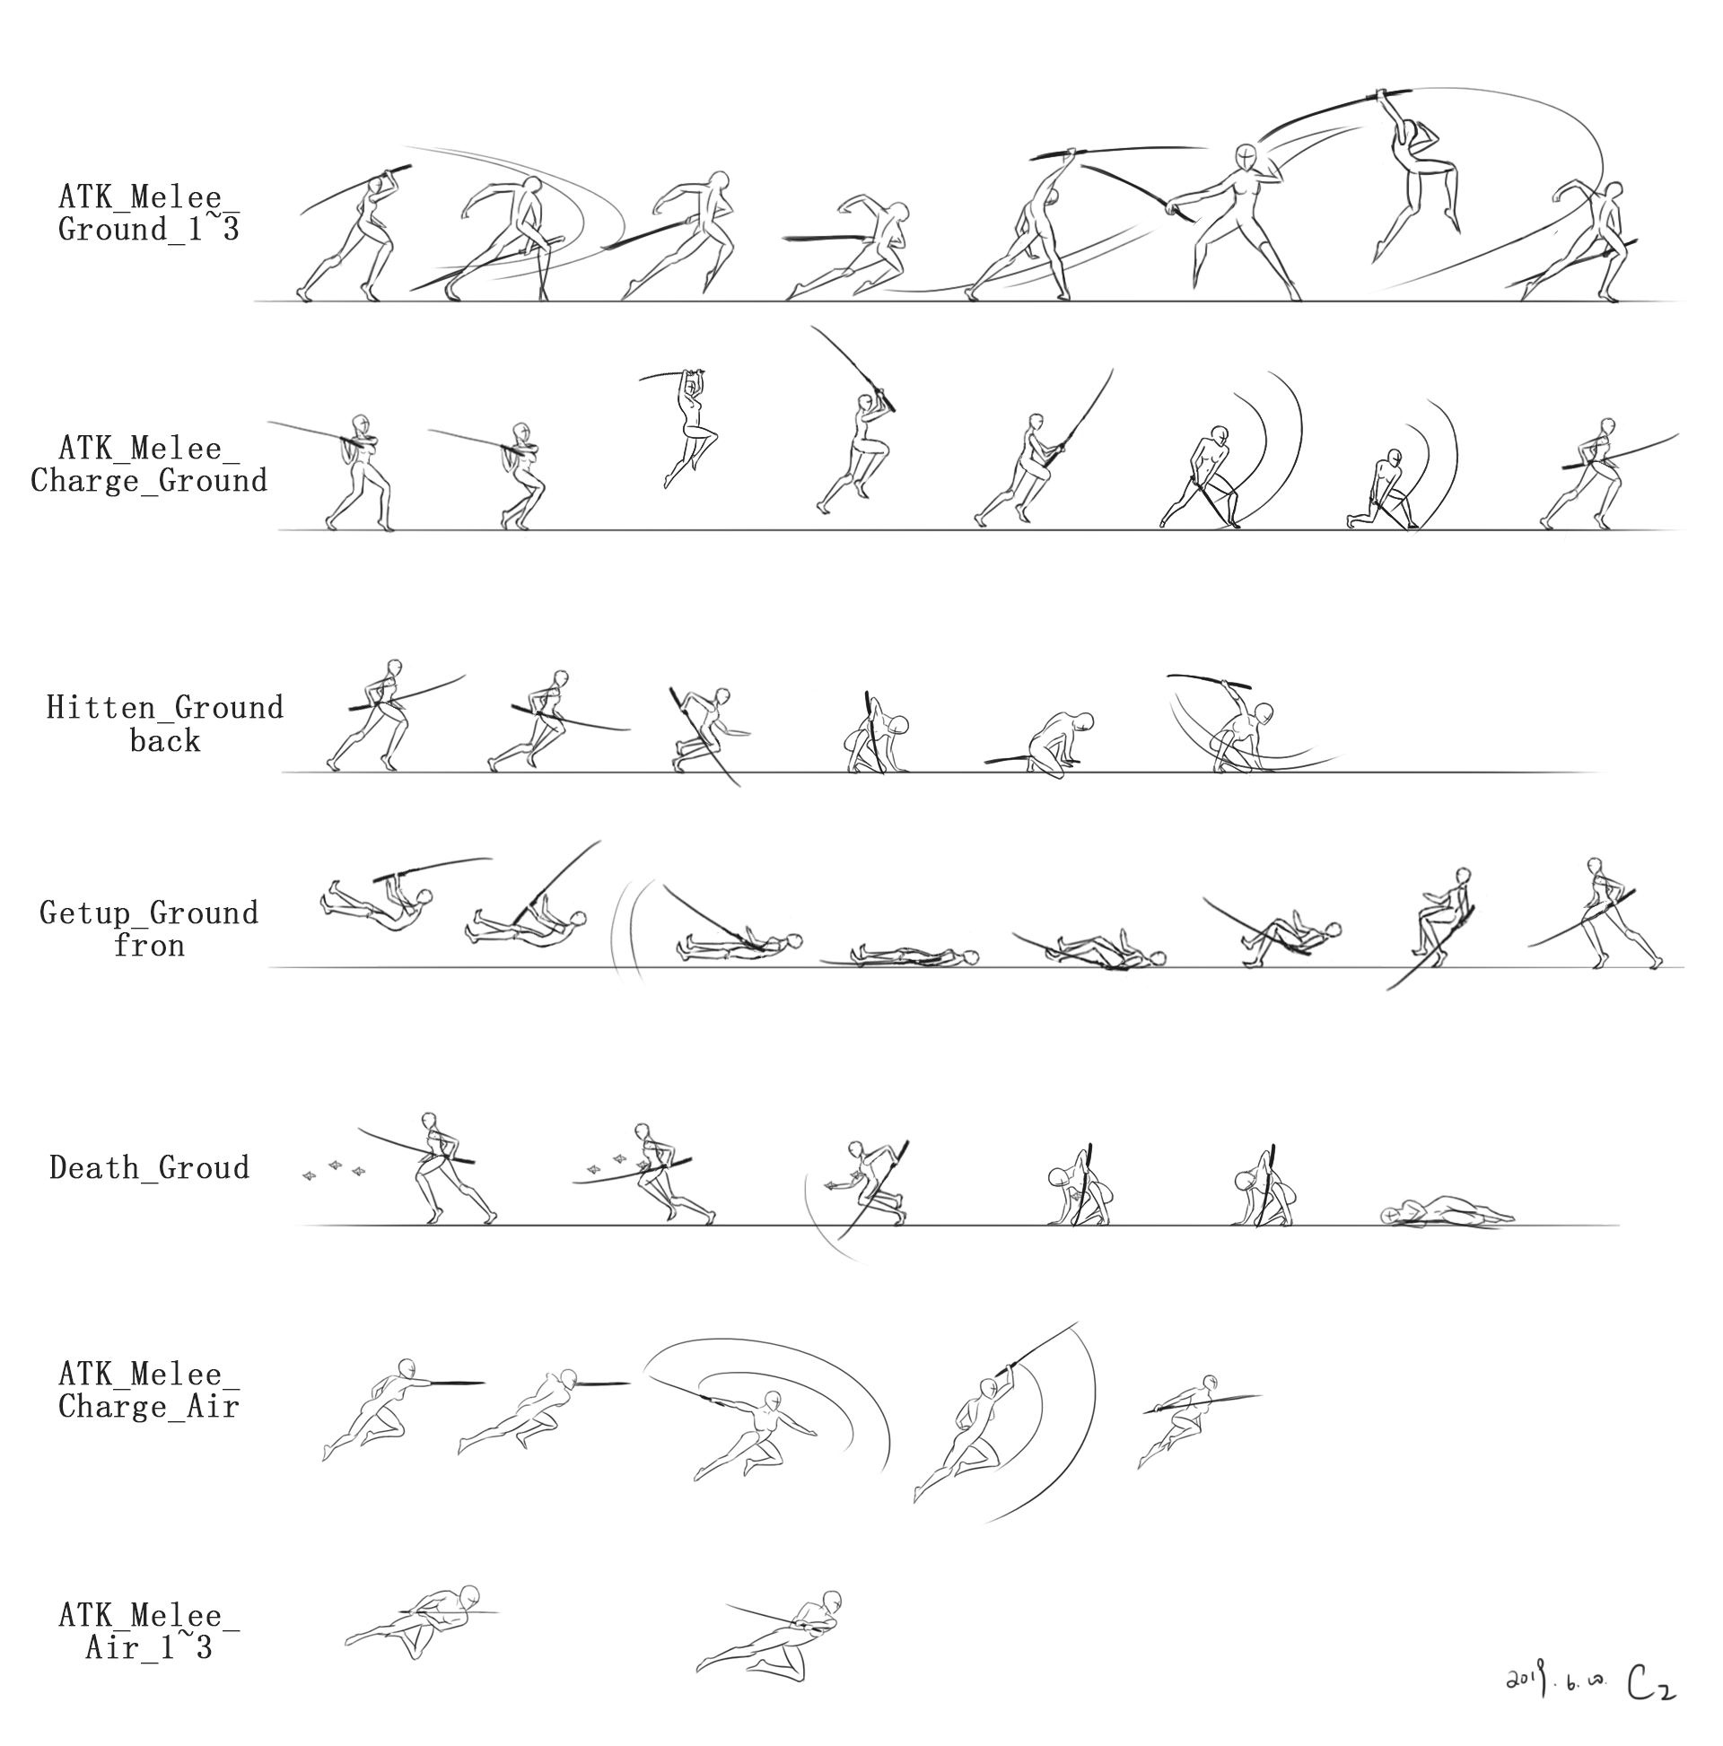
Action and Animation design
Animation type: skeletal animation
Software: DragonBones
Design pipeline：We regarded the action design and animation as the core experience of the action games, based on that we designed the character action set combined with the combat system. The pipeline is ‘Concept → Action → Key Frame → rigging’.

Slide 11
Thank You!

